Slide 1
Variable Ranking and Selection via Random Forests
Houtao Deng

Slide 2
Overview
Objectives
Advantages and Disadvantages of Random Forests on variable selection and ranking
New improvements
Agenda
Random Forests
Variable ranking
Variable selection

Slide 3
Random Forests
Decision tree
Splits are often based on information gain measured by entropy or Gini index .
Gini index of Y:
G(Y) =
Gini index after observing X:
G(Y|X) = Σ_{i} P(X=v_{i}) G(Y|X=v_{i})
Gini decrease:
ΔI = G(Y) – G(Y|X)
Notes:
Iterative, recursive partitioning of the input records
Splits use either categorical or numerical inputs
Classify into majority class at terminal nodes

Slide 4
Random Forests
Random forests
Step 1:
Create random
data (bootstrap samples)
Original
Training data
Randomize
D
....
Step 2:
Use random data to build
multiple decision trees
D
D
D
D
1
2
M-1
M
T
T
1
2
T_{M}
T_{M}
t -1
t
Step 3:
Combine decision trees
T
*
Vote on the most probable class
Ref: Introduction to Data Mining – Tan, Steinbach, Kumar
Notes:
Combines predictions made by multiple decision trees, where each tree is generated based on the values of an independent set of random vectors.
Each decision tree used a random vector that is generated from some fixed probability distribution. The first approach is to randomly select F input features to split at each node of the decision tree. The decision to split a node is then determined from the selected F features. The tree is grown to its entirety without pruning .
The predictions are combined using a majority voting scheme.

Slide 5
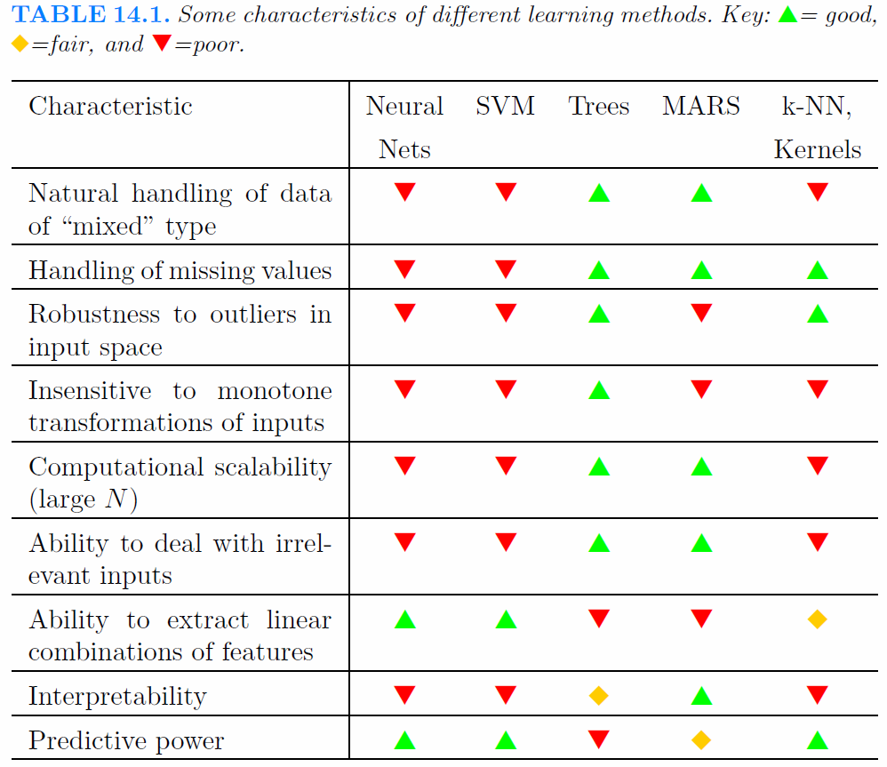
Random forest

Slide 6
Variable Ranking
Overview of variable ranking
In supervised learning (classification and regression), variable ranking is to rank the predictor variables according to their contributions regarding predicting the response variable.
The key for variable ranking is to define an importance metric for each variable

Slide 7
Variable Ranking
Importance metrics
Univariate:
Information Gain, Gini Index, Chi-square, correlation coefficient, etc.
Disadvantages: consider one variable’s contribution without other variables’ influences
Logistic regression
ln[p(Y=1)/(1-p(Y=1))] =α + βX, where β= (β₁, β₂,... β_{K}) can be used to evaluate the importance of each variable
Disadvantages:
Assumption of linearity in terms of the logit function versus the predictor variables
Different units of variables make it a little bit harder to interpret the coefficients
Categorical variables usually need to be transformed to binary variables
Decision trees like C4.5 and CART
Decision trees intrinsically evaluate each variable’s importance when selecting the best variable to split.
Advantages:
Handle nonlinear interactions, different variable units, mixed numerical and categorical variables, etc.
Disadvantages:
The accuracy of C4.5/CART is limited, and thus the importance score from these classifiers may be not reliable

Slide 8

Variable Ranking
Variable importance score from random forests
Gini index:
Gini index Y: G(Y)=
G(Y|X) = Σ_{i} P(X=v_{i}) G(Y|X=v_{i})
Gini decrease due to observing X: ∆I = G(Y) – G(Y|X)
For a single tree:
For random forest
Advantages
Accurately capture the relationship between predictor variables and the response variable
Scale independent
Naturally handle categorical and numerical variables
Gini decrease due to X_{i} at node t of tree T
Average over all trees

Slide 9
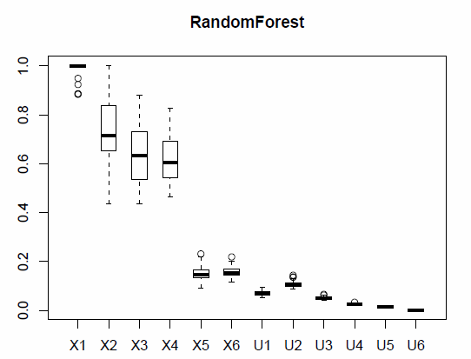
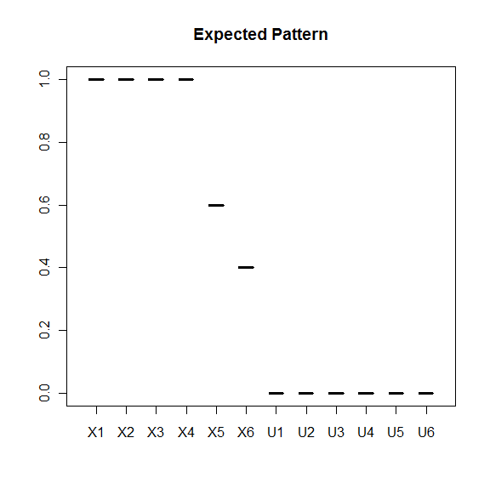
Variable Ranking
Bias of Random Forest for multi-valued categorical variables
Random Forest importance score is biased toward the variables having more values ^{[H. Deng etc. 2011]}
A
A
B
C
C
B
D
D
Importance:
I(X1)=I(X2)=I(X3)=I(X4) > I(X5)>I(X6)>I(Ui)
Variable types:
X1 and U1: continuous; Others are categorical
Number of levels:
L(X2)>L(X3)>L(X4);
L(X6)>L(X5);
L(U2)>L(U3)>...>L(U6)

Slide 10
Variable Ranking
Solution 1: OOB Forest ^{[H. Deng, G. Runger 2011]}
Notation:
A random sample d_{i} from the training data D is used growing a random tree i.
d_{-i} = D – d_{i} (out-of-bag )
Intuition:
Random Forest is greedy in that: d_{i} is used for selecting the splitting variable at each node, but also used for selecting the splitting value of that variable.
OOB Forest is try to make the RF less greedy by using d_{-i} to decide the splitting variable and using d_{i} to decide the splitting value of that variable

Slide 11
Variable Ranking
Solution 1: OOB Forest
d_{-i}
d_{i}
d_{-i}
d_{i}
Random Forest
OOB Forest

Slide 12
Variable Ranking
Solution 2: pForest ^{[H. Deng, G. Runger 2011]}
Intuition:
An informative variable X_{i} is expected to have a larger RF importance score than its randomly permuted version Z_{i}
However, if Z_{i} is a completely permuted version, any X_{i} can easily beat Z_{i} . And thus partial permutation of X_{i} is used in this approach: permute δ (0%-100%) of the rows of X_{i}
Procedure:
Permute δ (percentage) rows of variable X_{i} to Z_{i}
Augment the original data set [X,Y] to [X,Z,Y], where X and Z are the predictor variables, and Y is still the response variable
Build R replicates of random forests on [X,Z,Y]; and calculate the importance of X_{i} as:
Partial permute
δ =60%
X2
5
2
4
1
7
Z2
2
4
5
1
7
I: indicator function

Slide 13
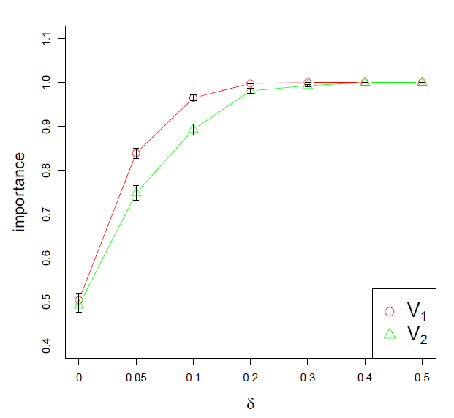
Variable Ranking
Selection of δ of pForest

Slide 14
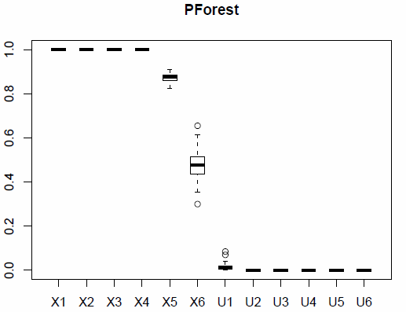
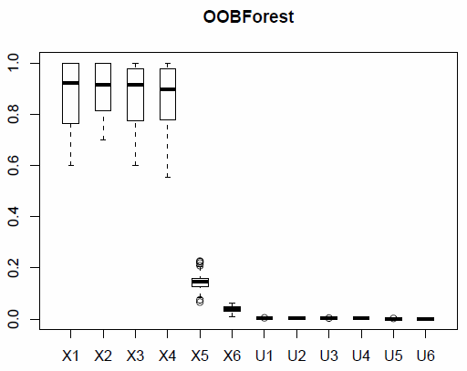
Variable Ranking
Experiments and Results
Expected Pattern
Random Forest
A
A
B
C
C
B
D
D
pForest
OOB Forest
A
A
B
C
B
C
D
D

Slide 15
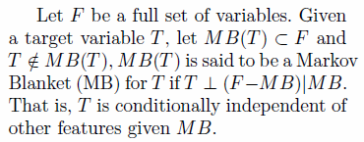
Variable Selection
Variable selection: Markov blanket criterion
Objective: find a minimum set of variables that contain all the information about predicting Y.
In practice, empirical errors from a classifier are often used as the evaluation criterion:
less error rate -> more information in the variables
2^{P} combinations of variable subsets.

Slide 16
Variable Selection
Relevancy and redundancy
Relevancy: contribution of a predictor variable regarding predicting the response variable
Redundancy: similarity between two predictor variables regarding predicting the response variable
Variable Ranking
Variable Selection
X₁
X₄ (similar to X₁)
X₃
X₁₀
X₈
X₁₂ (unimportant)
X₁
X₃
X₁₀
X₈

Slide 17
Variable Selection
Filter methods
Independent of a particular learner
Information-based algorithms:
Relevancy: I(Y, X_{k}); Redundancy: I(X_{i},X_{k})
Many algorithms use a combination of I(Y, X_{k}) and I(X_{i} , X_{k}) as the objective function to search the best subset of variables
CFS: correlation-based feature selection [M. Hall, 2000]
FCBF: fast correlation-based filter [L. Yu, etc. 2003]
mRMR: minimum-redundancy maximum-relevance feature selection [H. Peng, etc. 2003]
Disadvantages: can capture only two-way interactions between variables. e.g. Relationship(X1,X2) or Relationship(Y,X1). But they are not able to capture the relationship like: Y=XOR(X1,X2), in which neither X1 nor X2 individually is predictive, but X1 and X2 together can correctly determine Y.

Slide 18
Variable Selection
Embedded methods
LASSO (least absolute shrinkage and selection operator) ^{[R. Tibshirani, 1996]} :
Advantage: one-pass, i.e. only need to build one model
Disadvantage: LASSO is not among the most accurate classifiers in general, and thus the variables selected may be not the most informative sub set
Recursive Feature Elimination Framework
Consists of multiple iterations. At each iteration, drop the least important variable.
Strong classifiers can fit into this framework:
Support vector machine (drop the variable with the least coefficient of the learned hyperplane) [I. Guyon, etc. 2002]
varSelRF(drop the variable with the least importance score) [R. Uriarte, etc. 2006]
Disadvantage: computationally expensive: potentially need to build P models for P predictor variables.

Slide 19
Variable Selection
Regularized random forest (RRF) ^{[H. Deng, G. Runger 2012]}
A one-pass embedded method based on a strong classifier is very desirable
RRF was inspired by LASSO:
MIN (empirical loss + λ ||β||₁ )
Ordinary Random Forest:
Maybe add some penalty on the variable size?
MAX (information gain)

Slide 20

Variable Selection
Regularized Random Forest (RRF)
Intuition
Avoid selecting a new variable that is similar to the variables already selected in previous tree nodes.
Procedure
A regularized information gain is considered:
The tree regularization framework can be easily applied to many tree models.
where F is the variable set selected in previous nodes, gain(X) is the information gain measure in ordinary trees, λ∈[0,1] is called the coefficient. A smaller λ leads to a larger penalty and thus fewer variables are expected to be selected.

Slide 21
Variable Selection
Regularized Random Forest (RRF)
Illustration of the tree regularization (for simplicity, random sampling features is not considered here): X1, X2, X3, with λ=0.8, a depth-first tree (leaf nodes not shown): node 1-> node 2 -> node 3 -> node 4 -> node 5
node 1
gain(X1) = 0.2
gain(X2) = 0.3
gain(X3) = 0.2
F={}
gain_{R}(X1) = 0.2*0.8=0.16
gain_{R}(X2) = 0.3*0.8=0.24
gain_{R}(X3) = 0.2*0.8=0.16
F={X2}
gain_{R}(X1) = 0.1*0.8=0.08
gain_{R}(X2) = 0.1
gain_{R}(X3) = 0.12*0.8=0.096
F={X2}
X2
gain(X1) = 0.1
gain(X2) = 0.1
gain(X3) = 0.12
F={X2}
X2
node 2
node 4
node 3
X2
gain(X1) = 0.02
gain(X2) = 0.05
gain(X3) = 0.02
F={X2,X3}
node 5
X3
gain_{R}(X1) = 0.02*0.8=0.016
gain_{R}(X2) = 0.05
gain_{R}(X3) = 0.02
F={X2,X3}
gain(X1) = 0.1
gain(X2) = 0.05
gain(X3) = 0.11
F={X2}
X3
gain_{R}(X1) = 0.1*0.8=0.08
gain_{R}(X2) = 0.05
gain_{R}(X3) = 0.11*0.8=0.088
F={X2,X3}
gain(X1) = 0.06
gain(X2) = 0.05
gain(X3) = 0.06
F={X2,X3}
gain_{R}(X1) = 0.06*0.8=0.048
gain_{R}(X2) = 0.05=0.05
gain_{R}(X3) = 0.06
F={X2,X3}

Slide 22


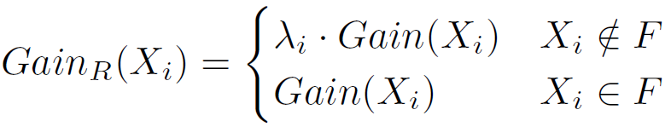
Variable Selection
Guided Regularized Random Forest (GRRF) ^{[H. Deng, G. Runger 2012} ]
Motivation: the variable selection process is greedy in that variables are evaluated at a local node.
Intuition: Use a less-greedy importance score to give the important variables advantages
Procedure:
Build an ordinary random forest and get the importance score for each variable: imp₁⁰ , imp₂⁰ , imp₃⁰ , ... imp_{P}⁰
Normalize the importance score:
Calculate the guided coefficient:
The regularized information gain:

Slide 23
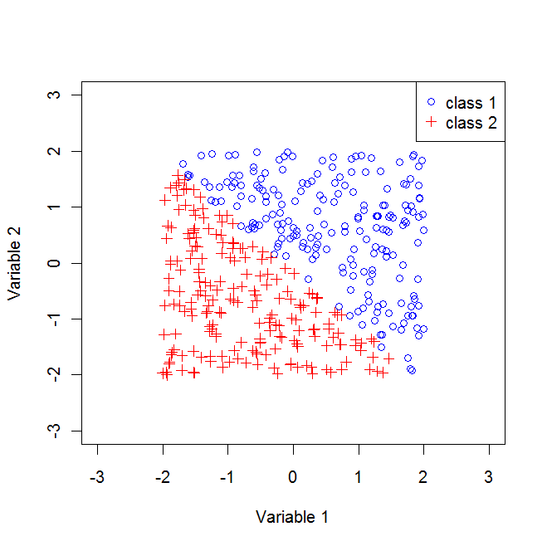
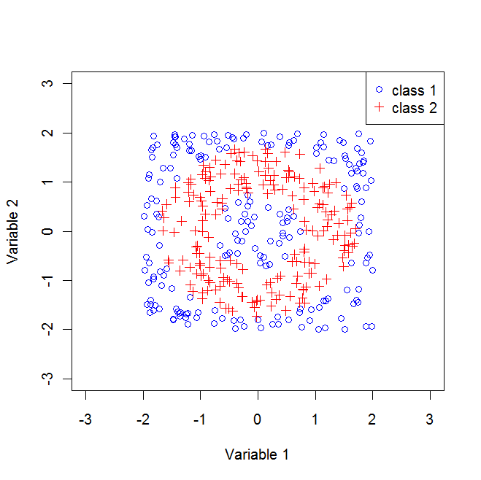
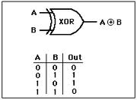
Variable Selection
Experiments: simulated data
Consider LASSO, CFS (correlation variables selection), RRF (regularized random forest), RF-RFE (random forest with RFE)
In all data sets, only 2 out of 100 variables are needed for classification.
Linear Separable
LASSO, CFS, RF-RFE, RRF
Nonlinear
CFS, RF-RFE, RRF
XOR data
RRF, RF-RFE

Slide 24
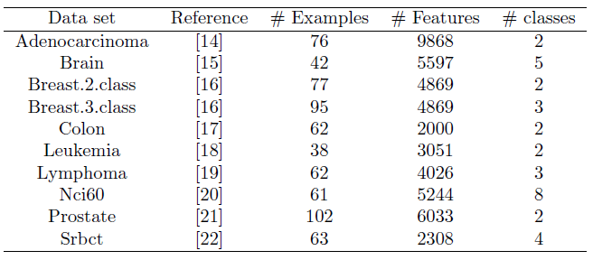
Variable Selection
Experiments: high-dimensional data
10 Gene data sets
For GRRF, use λ₀=1 and use 10-fold CV to select the best γ.

Slide 25
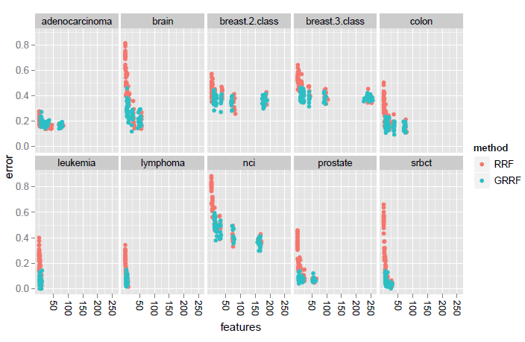
Variable Selection
GRRF is more accurate and more stable than RRF
Given similar number of variables, GRRF produces less error rates

Slide 26
Summary
Random Forests have many advantages in variable selection and ranking
The ordinary random forest is biased towards categorical variables with more values. OOB Forest and pForest are two solutions.
The regularized tree framework can be easily applied to many tree models
Guided regularized random forest produces better results than regularized random forest

Slide 27
References
Houtao Deng, George Runger, "Gene Selection with Guided Regularized Random Forest", technical report, 2012.
Houtao Deng, George Runger, "Feature Selection via Regularized Trees", Proceedings of the 2012 International Joint Conference on Neural Networks (IJCNN), IEEE, 2012.
Houtao Deng, George Runger, Eugene Tuv, "Bias of Importance Measures for Multi-Valued Attributes and Solutions", Proceedings of the 21st International Conference on Artificial Neural Networks (ICANN 2011), pp 293-300.

